Slide 1
Database Systems
Lecture 4
Three Schema Architecture and Data Independence

Slide 2
Today’s agenda
Three Schema Architecture
Internal level
Conceptual level
External or view level
Data independence
Logical data independence
Physical data independence

Slide 3
Three-Schema Architecture
Proposed to support DBMS characteristics of:
Program-data independence.
Support of multiple views of the data.
Use of a catalog to store the database description

Slide 4
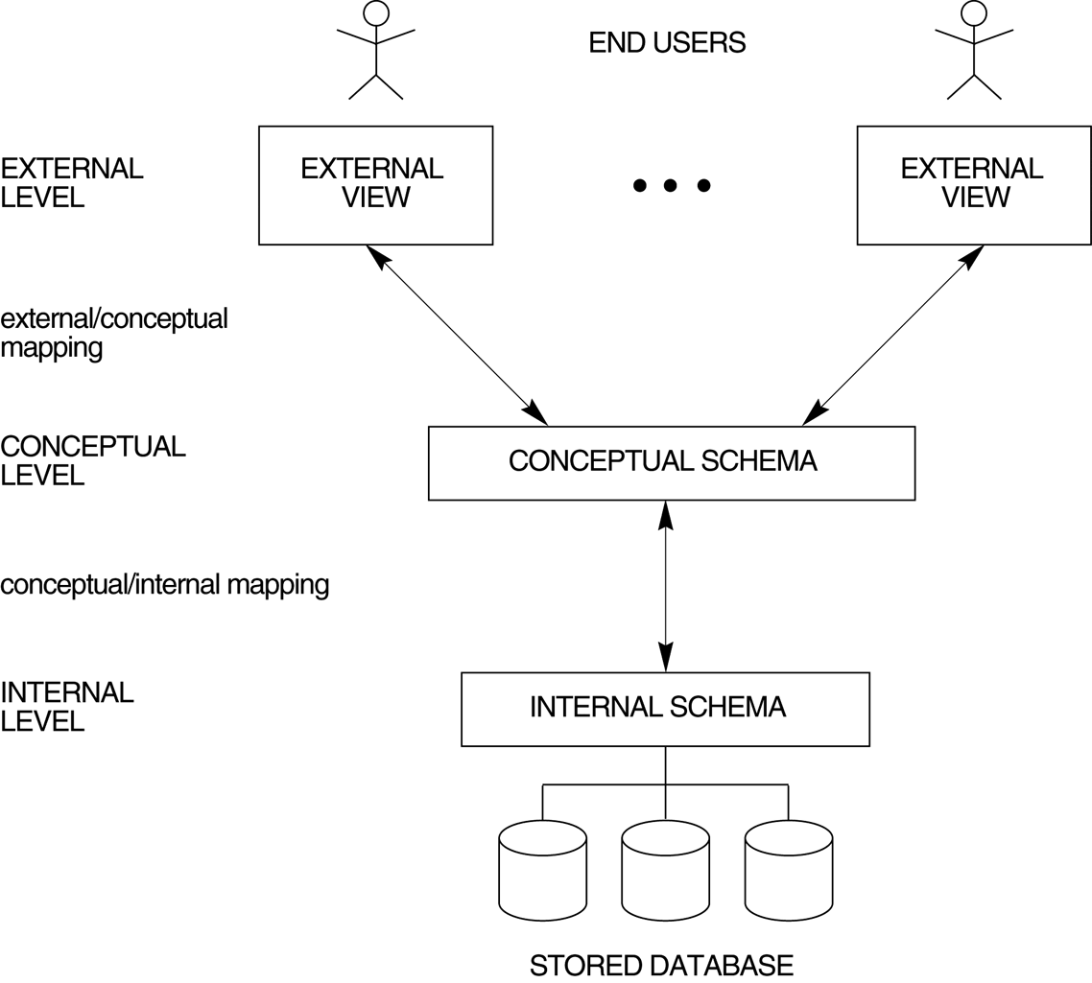
The Three Schema Architecture

Slide 5
Three-Schema Architecture
Goal is to separate the user application and the physical database:
Internal schema
Conceptual schema
External schemas

Slide 6
Internal schema
Internal schema at the internal level to describe physical storage structures and access paths. Typically uses a physical data model and describes the complete detail of the data storage.

Slide 7
Conceptual schema
Conceptual schema at the conceptual level to describe the structure and constraints for the whole database for a community of users. Uses a conceptual or an implementation data model which hides the details of physical storage structures and concentrates on describing entities, data types, relationships, user operations, and constraints i.e. representational model

Slide 8
External schema
External schemas at the external or view level to describe the various user views. Usually uses the same data model as the conceptual level. Describes the part of the database that a particular user group is interested in and hides the rest of the database from that user group.

Slide 9
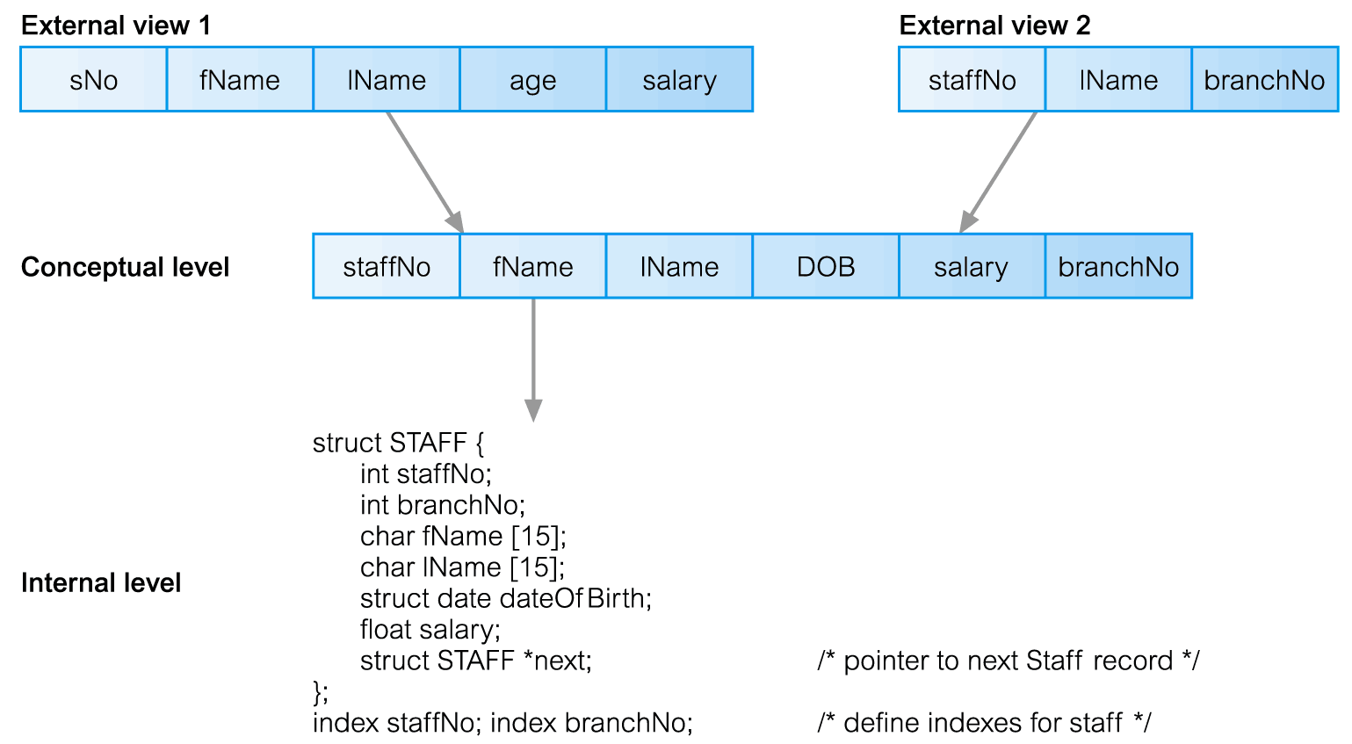
Differences between Three Levels of ANSI-SPARC Architecture

Slide 10
Three-Schema Architecture
three schemas are only descriptions of data; the only data that actually exists is at the physical level.
In a DBMS based on the three-schema architecture, each user group refers only to its own external schema.
Hence, the DBMS must transform a request specified on an external schema into a request against the conceptual schema, and then into a request on the internal schema for processing over the stored database.
If the request is a database retrieval, the data extracted from the stored database must be reformatted to match the user’s external view.

Slide 11
Three-Schema Architecture
Mappings among schema levels are needed to transform requests and data. Programs refer to an external schema, and are mapped by the DBMS to the internal schema for execution.
These mappings may be time-consuming, so some DBMSs-especially those that are meant to support small databases-do not support external views. Even in such systems, however, a certain amount of mapping is necessary to transform requests between the conceptual and internal levels.

Slide 12
Data Independence
Defined as capacity to change the schema at one level of a database system without having to change the schema at the next higher level.
We can define two types of Data independence:
Logical Data Independence
Physical Data Independence

Slide 13
Logical Data Independence
Logical Data Independence: The capacity to change the conceptual schema without having to change the external schemas and their application programs.
For example, we may change the conceptual schema to expand the database (by adding a record type or data item), to change constraints, or to reduce the database (by removing a record type or data item). In the last case, external schemas that refer only to the remaining data should not be affected.
Only the view definition and mappings need be changed in a DBMS that supports logical Data Independence

Slide 14
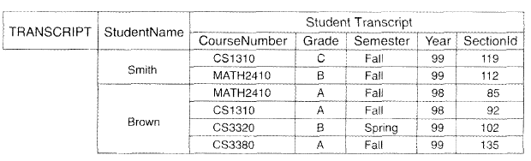
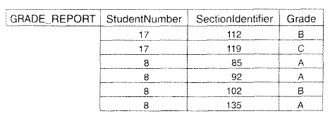
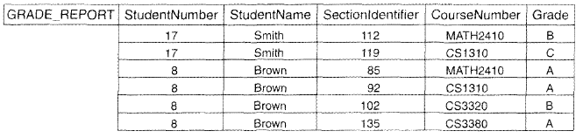
Logical Data Independence

Slide 15
Physical Data Independence
Physical Data Independence: The capacity to change the internal schema without having to change the conceptual schema. Changes to the internal schema may be needed because some physical files had to be reorganized-for example, by creating additional access structures-to improve the performance of retrieval or update. If the same data as before remains in the database, we should not have to change the conceptual schema.

Slide 16
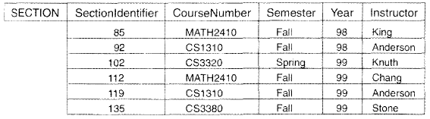
Physical Data Independence

Slide 17
Data Independence
When a schema at a lower level is changed, only the mappings between this schema and higher-level schemas need to be changed in a DBMS that fully supports data independence. The higher-level schemas themselves are unchanged. Hence, the application programs referring to the higher-level schema need not be changed.
Physical data independence (exact location of data, hardware details, compression, splitting) exists in most databases and file environments, however conceptual data independence is very hard to come

Slide 18
The three-schema architecture can make it easier to achieve true data independence, both physical and logical.
However, the two levels of mappings create an overhead during compilation or execution of a query or program, leading to inefficiencies in the DBMS. Because of this, few DBMSs have implemented the full three-schema architecture.

